Slide 1
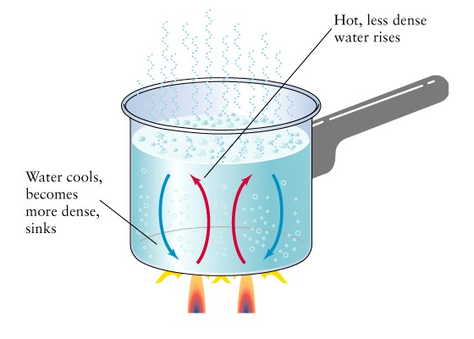

Convection
Convection is the
flow of currents
in a liquid or gas
A current is created when the warmer
(less dense) material rises forcing the
cooler (more dense) material to sink.
Notes:
Instructional Approach(s): The teacher should present the information on the slide while the students record the important information on their notes

Slide 2
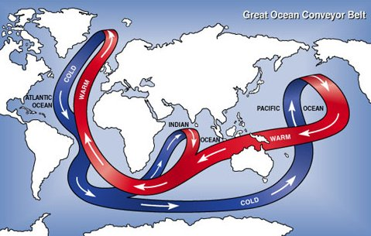
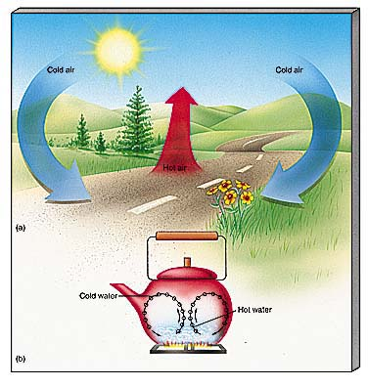
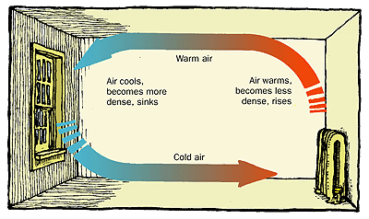
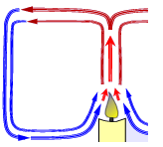
Everyday Examples of Convection Currents
http://www.healthyheating.com/Definitions/heat-transfer-convection.htm#.VD7SIfmjOSo
Notes:
Instructional Approach(s): Remind students that in the water cycle, warm air rises, cools and condenses. Students learned about convection currents and the water cycle in the 6th grade.

Slide 3
Describe an example of convection that you have experienced recently at home, at school, or outside.
Convection
Notes:
Instructional Approach(s): This could be used as a formative assessment tool.

Slide 4
Cold air sinks
Where is the freezer compartment put in a fridge?
Freezer compartment
It is warmer at the bottom, so this warmer air rises and a convection current is set up.
It is put at the top, because cool air sinks, so it cools the food on the way down.

Slide 5
IMPORTANCE OF CONVECTION CURRENTS

Slide 6
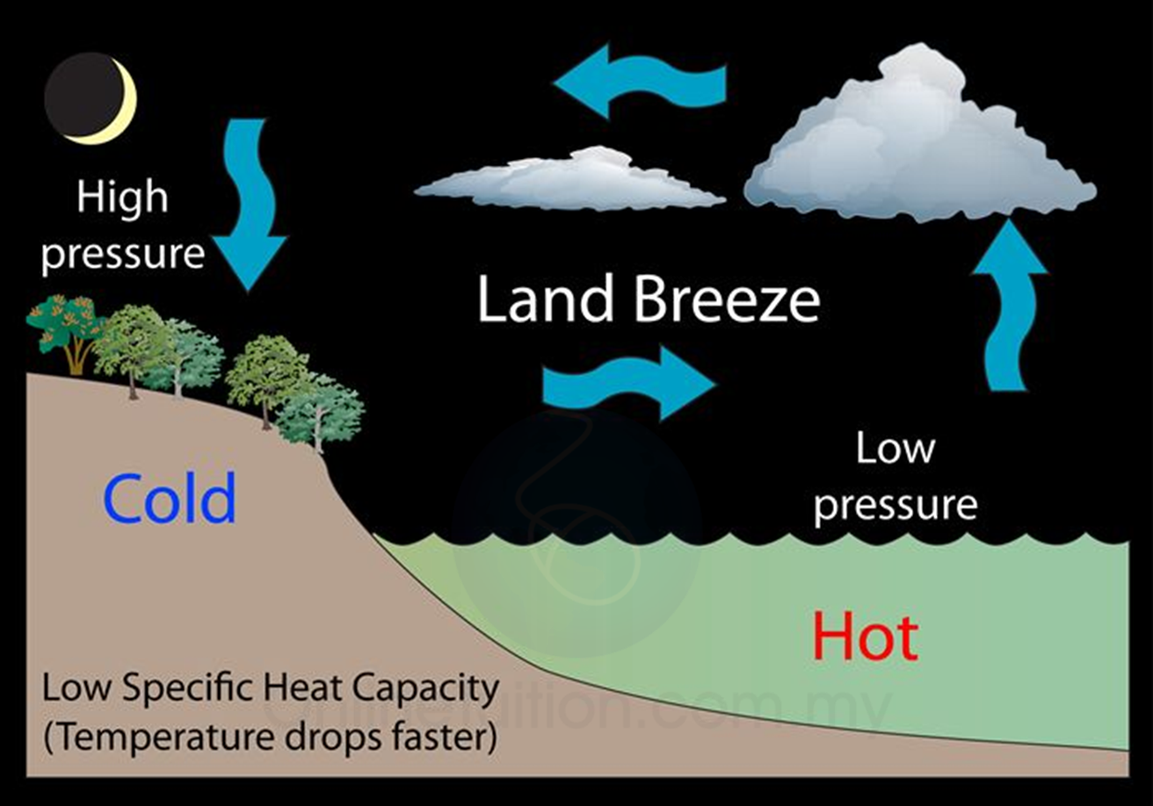
LAND BREEZE

Slide 7
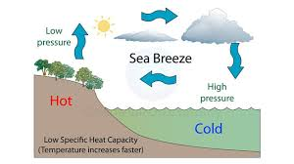
SEA BREEZE

